Slide 1
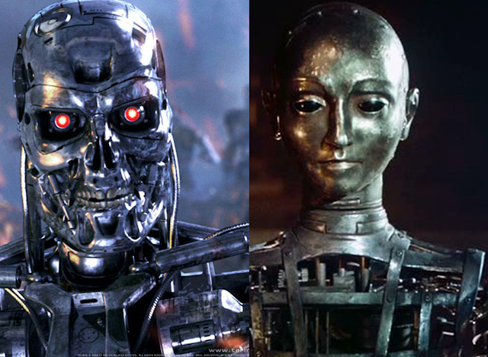
Theory Of Automata
<number>
Notes:
<number>

Slide 2
Lecture # ….
Theory of Automata
2

Slide 3
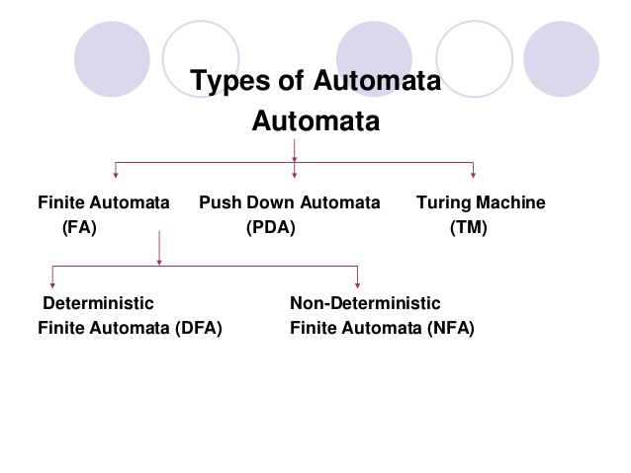
<number>

Slide 4
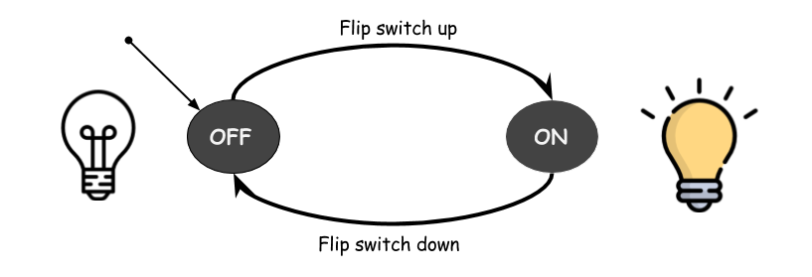
FINITE AUTOMATA
4

Slide 5
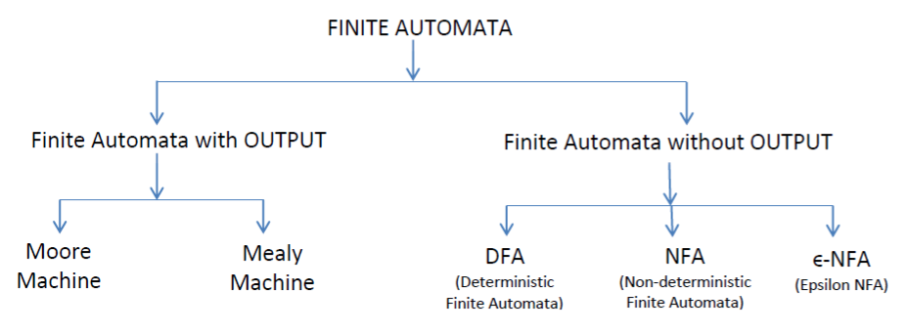
Types of Finite Automata
<number>

Slide 6
NON DETERMINISTIC
FINITE
AUTOMATA
6

Slide 7
2:Non Deterministic Finite Automata
* NFA stands for non-deterministic finite automata.
* It is easy to construct an NFA than DFA.
* It represents an abstract machine which is used to represent a regular language
* It has many paths for specific input from the current state to the next state.
6

Slide 8
* Every NFA is not DFA, but every DFA is NFA
* Each NFA can be translated into DFA.
* It is same as DFA except:
It contains multiple next states, and
It contains ε transition.
No need to define distinguishing rule
6

Slide 9
There are two ways to specify an NFA or NDFA:
1) Transition Tables and
2) Directed Graphs.
(same as DFA)

Slide 10
DFA consists of 5 tuples {Q, ∑, q, F, δ}.
Q : set of all states.
∑ : set of input symbols. ( Symbols which machine takes as input )
q : Initial state. ( Starting state of a machine )
F : set of final state.
δ : Transition Function,
defined as δ : Q X ∑ --> 2^Q.
<number>

Slide 11
Examples
1: Construct a NFA for a language L = {aa}
∑ = {a}
L ={aa} (Language with only one string aa)
a a
No need for a Dead State
q0
q1
q2
11

Slide 12
Transition Table
The indicates the start state: here q0
The * indicates the final state(s) (here only one final state q2)
STATE | INPUT a
q0 | q1
q1 | q2
* q2 | ϕ
12

Slide 13
2: Construct a NFA for a language L = {aba}
∑ = {a,b}
L ={aba} (Language with only one string aba)
a b a
q0
q1
q2
q3
13

Slide 14
Transition Table
STATE | INPUT a | INPUT b
q0 | q1 | ϕ
q1 | ϕ | q2
q2 | q3 | ϕ
*q3 | ϕ | ϕ
14

Slide 15
3: Construct a NFA with ∑ = {0, 1} accepts all strings starts with 0.
Also construct a Transition Table for the this NFA
Hint: First make the language for the above NFA.
15

Slide 16
Construct a NFA with ∑ = {0, 1} accepts all strings starts with 0.
L = {0,00,01,001,011,……..}
0,1
0
q0
q1
16

Slide 17
Here
q0 is initial or start state
On getting 0 input it goes to q1
q1 is the final state having self loop (having all combinations of 0 and 1 strings)
There is no need for the Dead State or Trap state in case of NFA
However, ϕ is equivalent to dead configuration
The strings which reaches the final state will only be accepted by NFA.
17

Slide 18
4: Construct a NFA with ∑ = {0, 1} accepts all strings ending with 0.
17

Slide 19
Construct a NFA with ∑ = {0, 1} accepts all strings ending with 0.
L= {0,00,10,000,100,110,0000,…….}
0,1
0
Construct a Transition Table for the above NFA
q0
q1
19

Slide 20
5:Construct a NFA that accepts set of all strings over {0, 1} of length 2 .
Also define 5 tuples for it .
<number>

Slide 21
∑ = {0, 1}
L ={00,01,10,11}
0,1 0,1
q0
q1
q2
21

Slide 22
6: Construct a NFA that accepts set of all strings ending with 100
<number>

Slide 23
∑ = {0, 1}
L ={100,0100,1100,01100,……..}
1 0 0
0,1
q0
q1
q2
q3
23

Slide 24
Designing Finite Automata from Regular Expression
1: Construct a NFA for R.E. = ab(a+b)*
(Hint: make strings (language) for the mentioned R.E).
Solution:
∑={a,b}
L= {ab,aba,abb,abaa,abab,abba,abbb,….}
<number>

Slide 25
Construct a DFA for R.E. = ab(a+b)*
a b
a,b
q0
q1
q2
24

Slide 26

Don’t forget to draw Transition Table and mention 5 tuples for the all of these examples.
<number>

